Slide 1
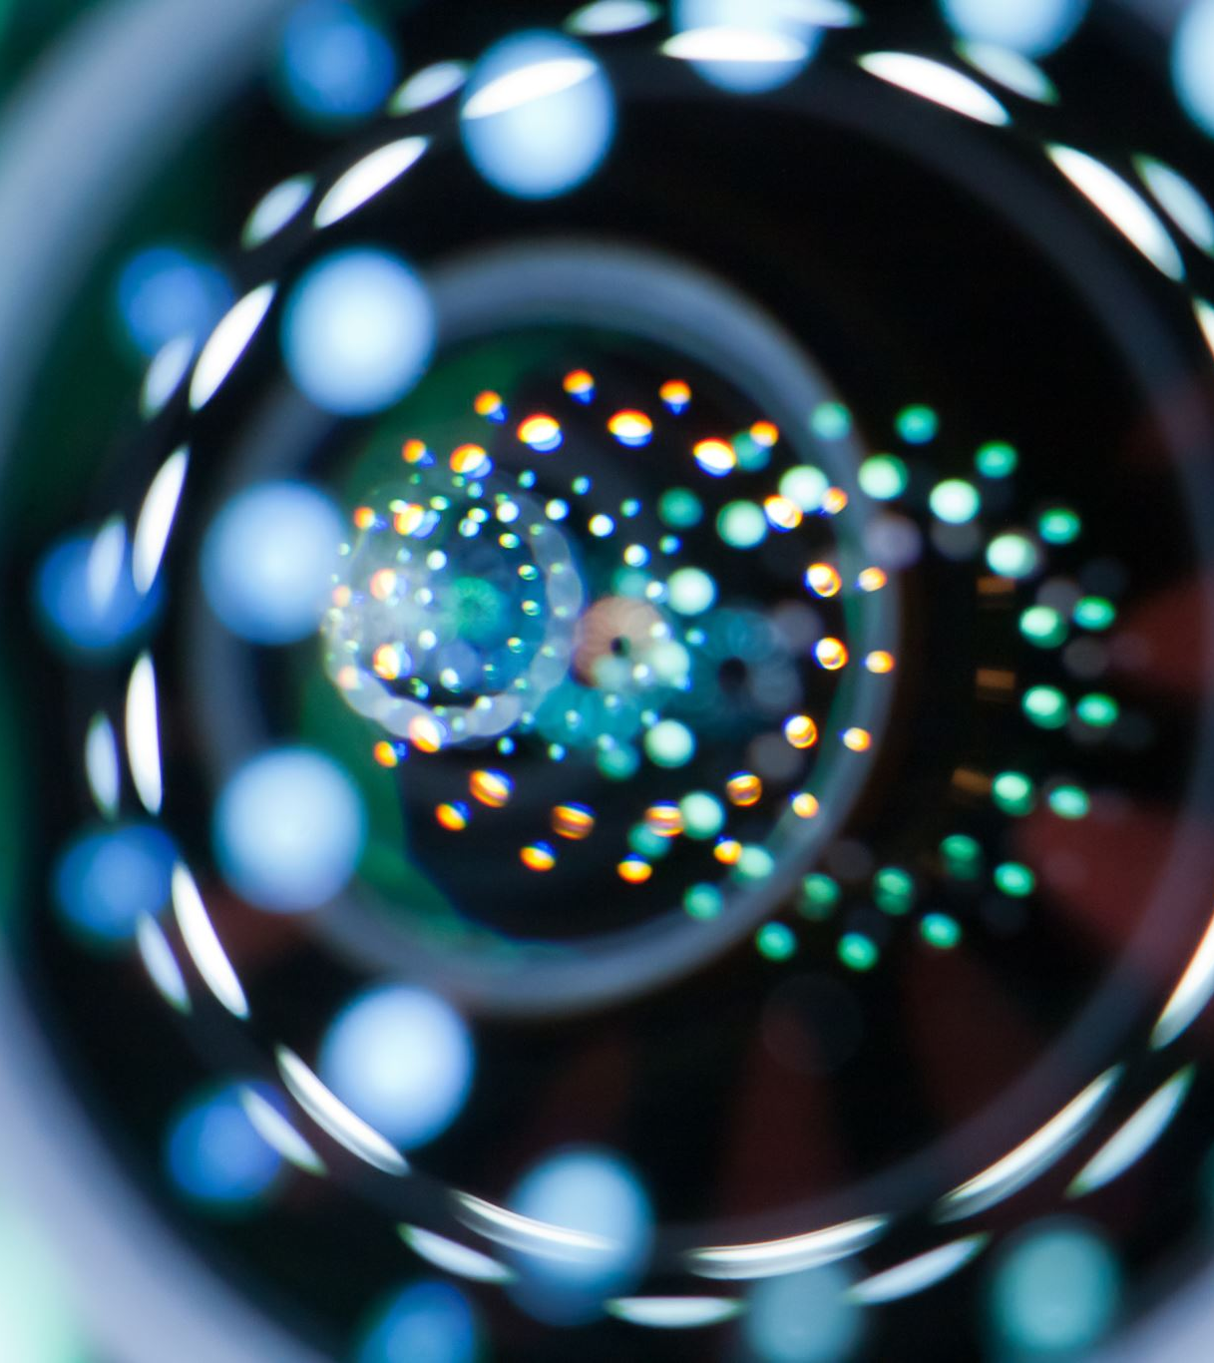
SMART on FHIR on PatientPoint

Slide 2
FHIR
FHIR (Fast Healthcare Interoperability Resources):
Originated in 2012
A standard for the secure exchange of healthcare data between different systems through APIs
Supported by major vendors: Google, Apple, Microsoft and EHRs: EPIC, Cerner, Meditech, etc.
Free to use

Slide 3
SMART on FHIR
SMART (Suitable Medical Applications Reusable Technologies)
Built on top of FHIR APIs
Originated out of Harvard Medical School with grants from the Office of the National Coordinator for Health Information Technology with recent implementation in the 21st Century Cures Act as a standard.
Creates a more organized and simplified layer on FHIR with a more recognized semantic layer for healthcare technologists.
Enables the creation of apps that are interoperable between systems such as EHRs. An analogy would be the substitutability of apps in an app store.
Free to use.

Slide 4



Example SMART ON FHIR Applications
Medocity MD: “Developed for care professionals to connect, track and monitor patients.”
Meducation Timeview: “Displays a patient’s medication adherence history in intuitive formats, enabling quick & appropriate interventions.”
MyLinks: “Full featured Personal Health Record with 36,000+ clinics using Allscripts, Epic, Cerner, NextGen, Meditech, eClinicalWorks, AthenaHealth, Virence.”
* Source: https://apps.smarthealthit.org/apps?sort=name-asc

Slide 5
Types of data available:
Vitals
Demographics
Conditions
Lab reports
Immunization
Medications
Medical implants
Appointments
Procedures/surgeries
Medical imaging
Financial/billing information
Insurance information
Allergies
Social history notes (Ex.: smoking 12 years)
* Thousands of data points available per patient including historical data.

Slide 6
SMART on FHIR
Potential Audiences
Patient-based
HCP-based
Patient/HCP
Potential Delivery Methods:
Stand alone App in an App store.
Stand alone Web-based application designed for any browser or phone.
App embedded in an HCP office’s EHR software.
Application embedded in a screen on a PatientPoint device.

Slide 7
SMART ON FHIR ON PatientPoint Devices
Patients and/or HCPs can interact with the screen to bring up patient specific information: lab results, medical history, etc.
Conveniently display patient’s medical imaging to HCPs and patients in an easy to view format in a way that most HCPs don’t have access to.
Once logged in, ads can be potentially tailored to a patient.

Slide 8
SMART ON FHIR Security
SMART manages security through OAuth 2.0 integration with the in place EHR.
An HCP could log in through their normal credentials they use for accessing their EHR records. They would then be presented with a list of their patients to choose from.
If the app was embedded in the HCP’s software, the credentials would be passed through and no need to re-login again.
For a standalone app that is patient focused such as on PatientPoint screen, the patient would log in with the credentials that the HCP generated for them to access their records or the HCP could log in with their credentials. PatientPoint would not be managing their credentials.

Slide 9
